Slide 1
Avionics
Led by Morgan Novak

Slide 2
Objectives:
Receive telemetry data from the rocket during launch
Stream video of rocket
Display data in an interesting way
Optional: Play sound from speakers at lift off and touchdown
Use LoRa to send sensor data from rocket to ground.
Sensors:
Barometer*
Altimeter*
Temperature*
Accelerometer
*all in one chip
Use FPV Drone Camera/Transmitter Package to send video from rocket to ground.
Display data from sensors and live video on monitor.
Port sensor data into launch control box.
Host website on Groundpi.
Backup: Firefly Camera that saves to SD card
Notes:
Morgan

Slide 3
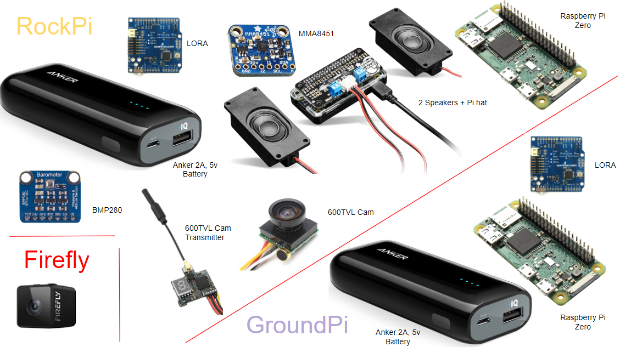
*Monitor not shown
Notes:
Morgan

Slide 4
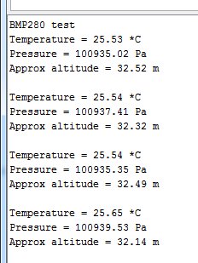
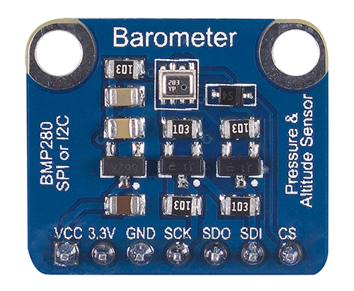
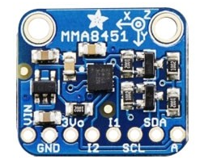
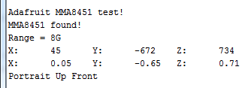
Sensors
RockPi
Barometer+Temperature+Altitude
Adafruit BMP280
SPI or I2C
Altitude based on pressure @ sea level (<10m)
Accelerometer
Adafruit MMA8451
I2C
Auto-tilt orientation detection
14 bit ADC
GND
SDA
GND
SDA
5V
3.3V
SCL
GND
SCL
Notes:
Morgan

Slide 5
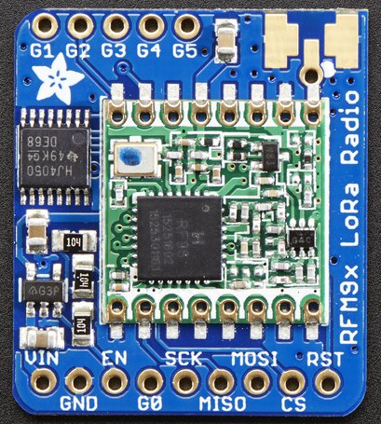
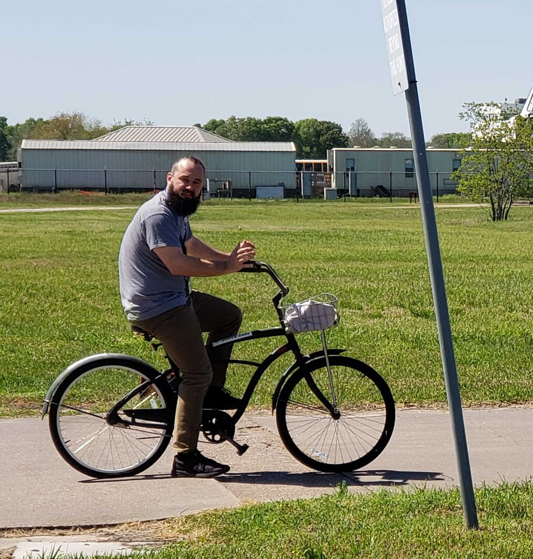
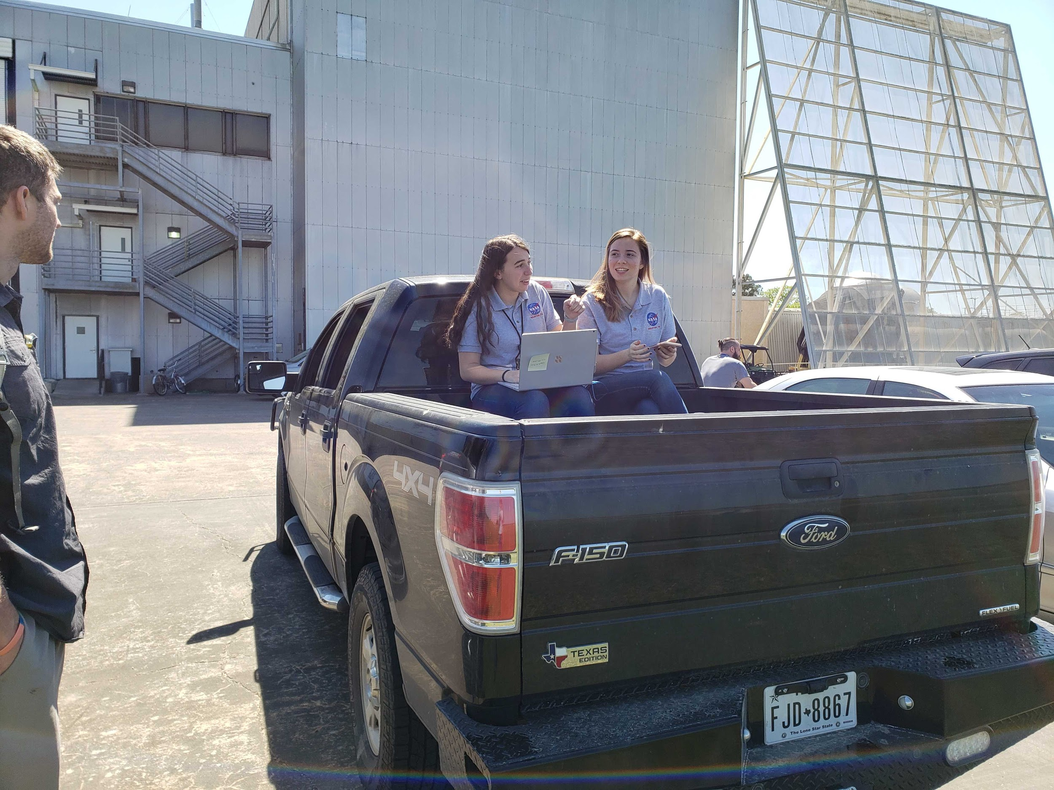
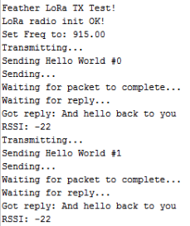
LoRa
RockPi + GroundPi
Radio GPIO
Antenna
Used to send sensor data from RockPi to GroundPi
SPI
Sends/receives packets over 2km
Range Testing on B14 Antenna Range
~1,874 ft
5V
GND
CLK
MISO
MOSI
CS
RST
G0
Notes:
Kathryn

Slide 6
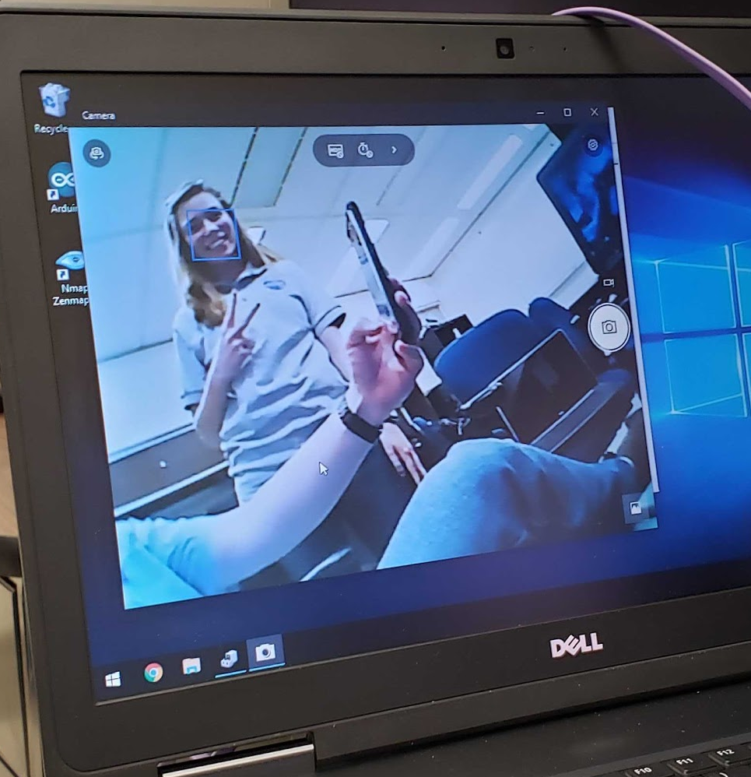
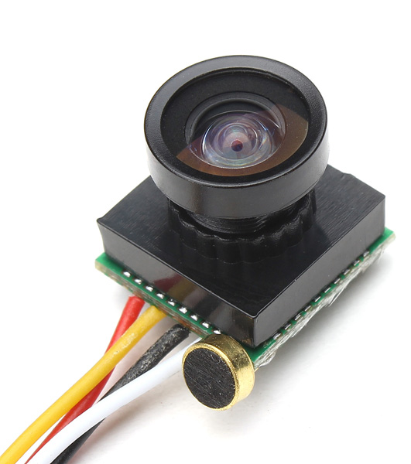
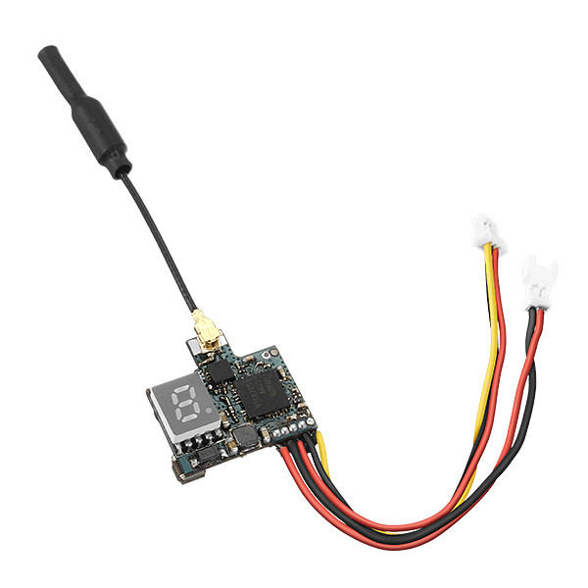
FPV Camera + Transmitter
RockPi
600TVL 1/4 1.8mm CMOS FPV 170 Degree Wide Angle Camera
PAL/NTSC
3.7-5V
Eachine VTX02 Super Mini 5.8G 40CH 200mW FPV Transmitter
No audio
3.3V
Camera Transmitter
Transmitter Pi
POWER ONLY
Notes:
Kolten

Slide 7
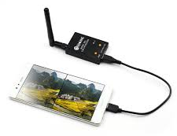
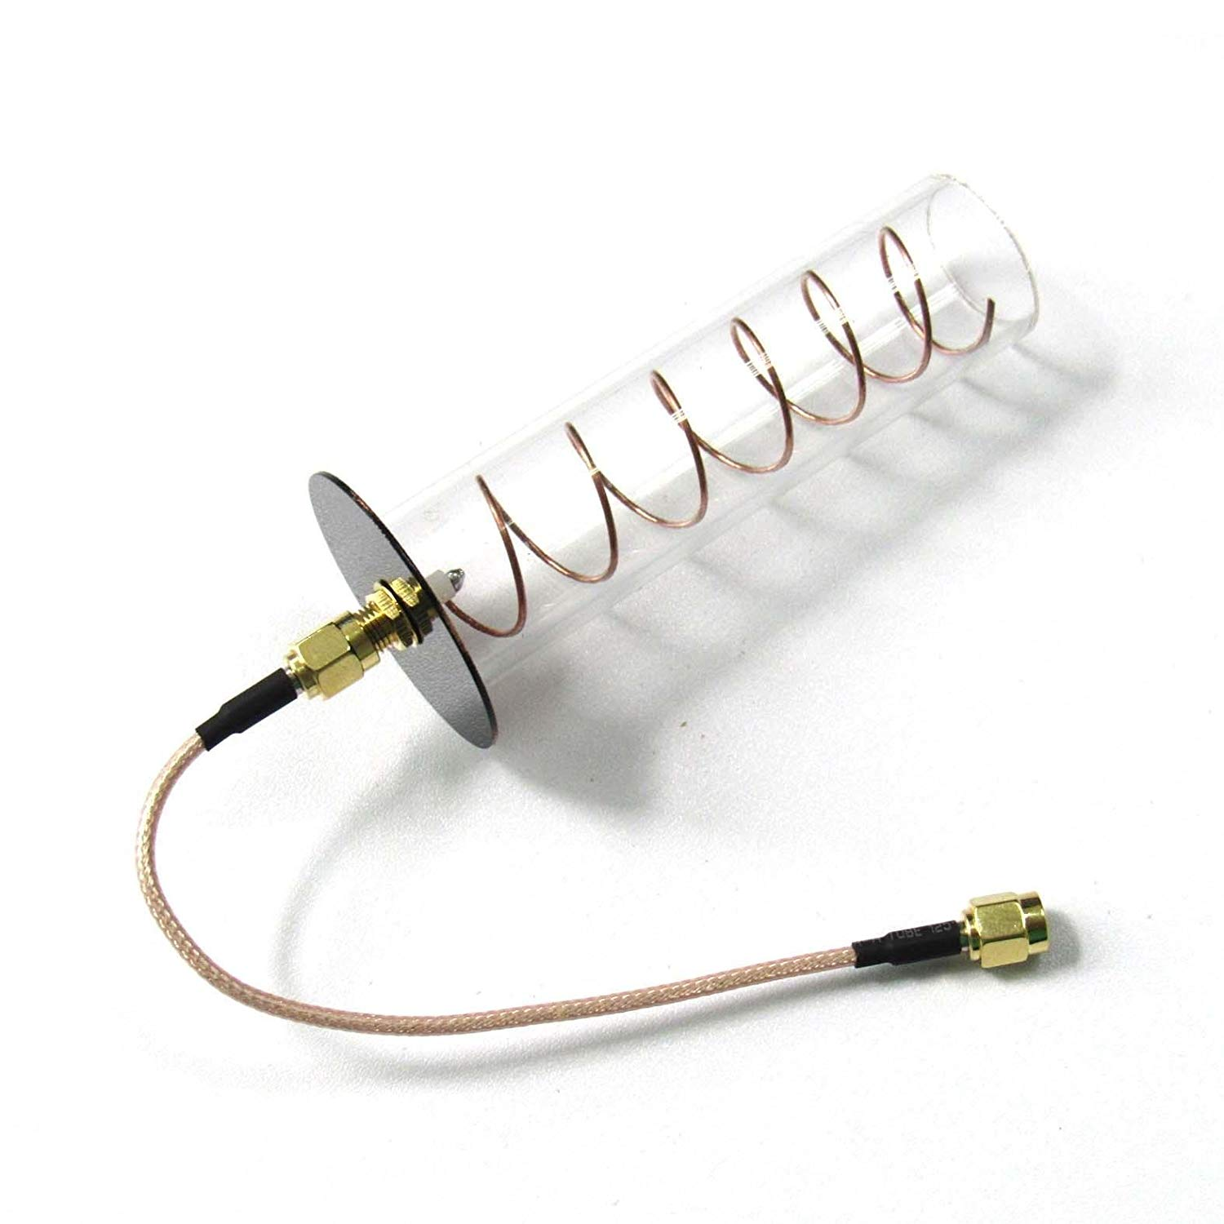
FPV Receiver
GroundPi
Eachine ROTG01 UVC OTG 5.8G 150CH Full Channel FPV Receiver
Range: 1476.38ft
Plugs into PC
Range: 3280.84ft
*Ranges are as advertised, did not have time to test
Notes:
Kolten

Slide 8
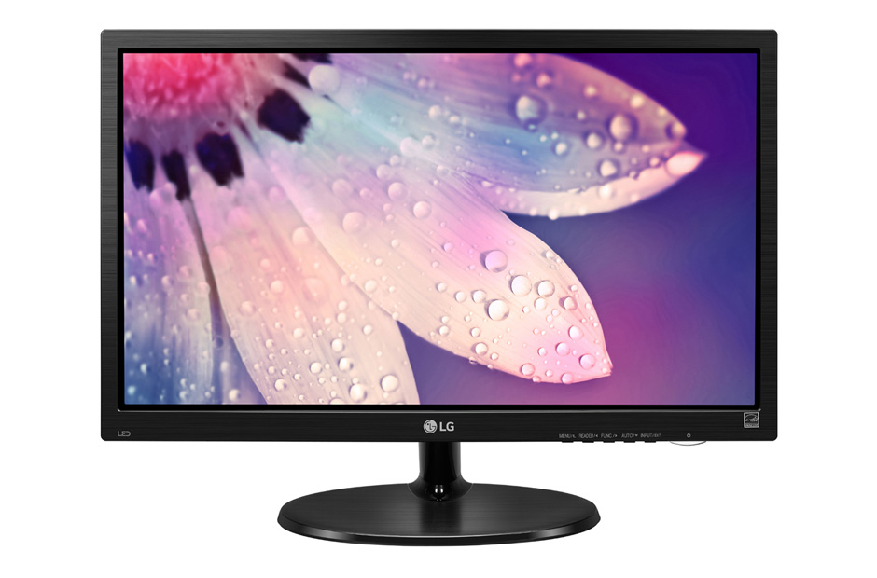
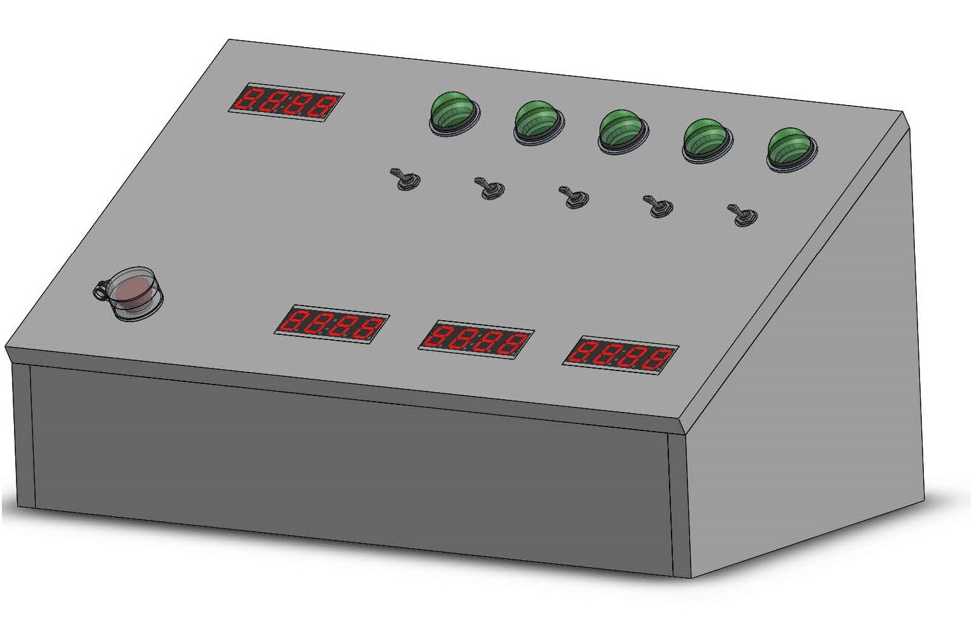
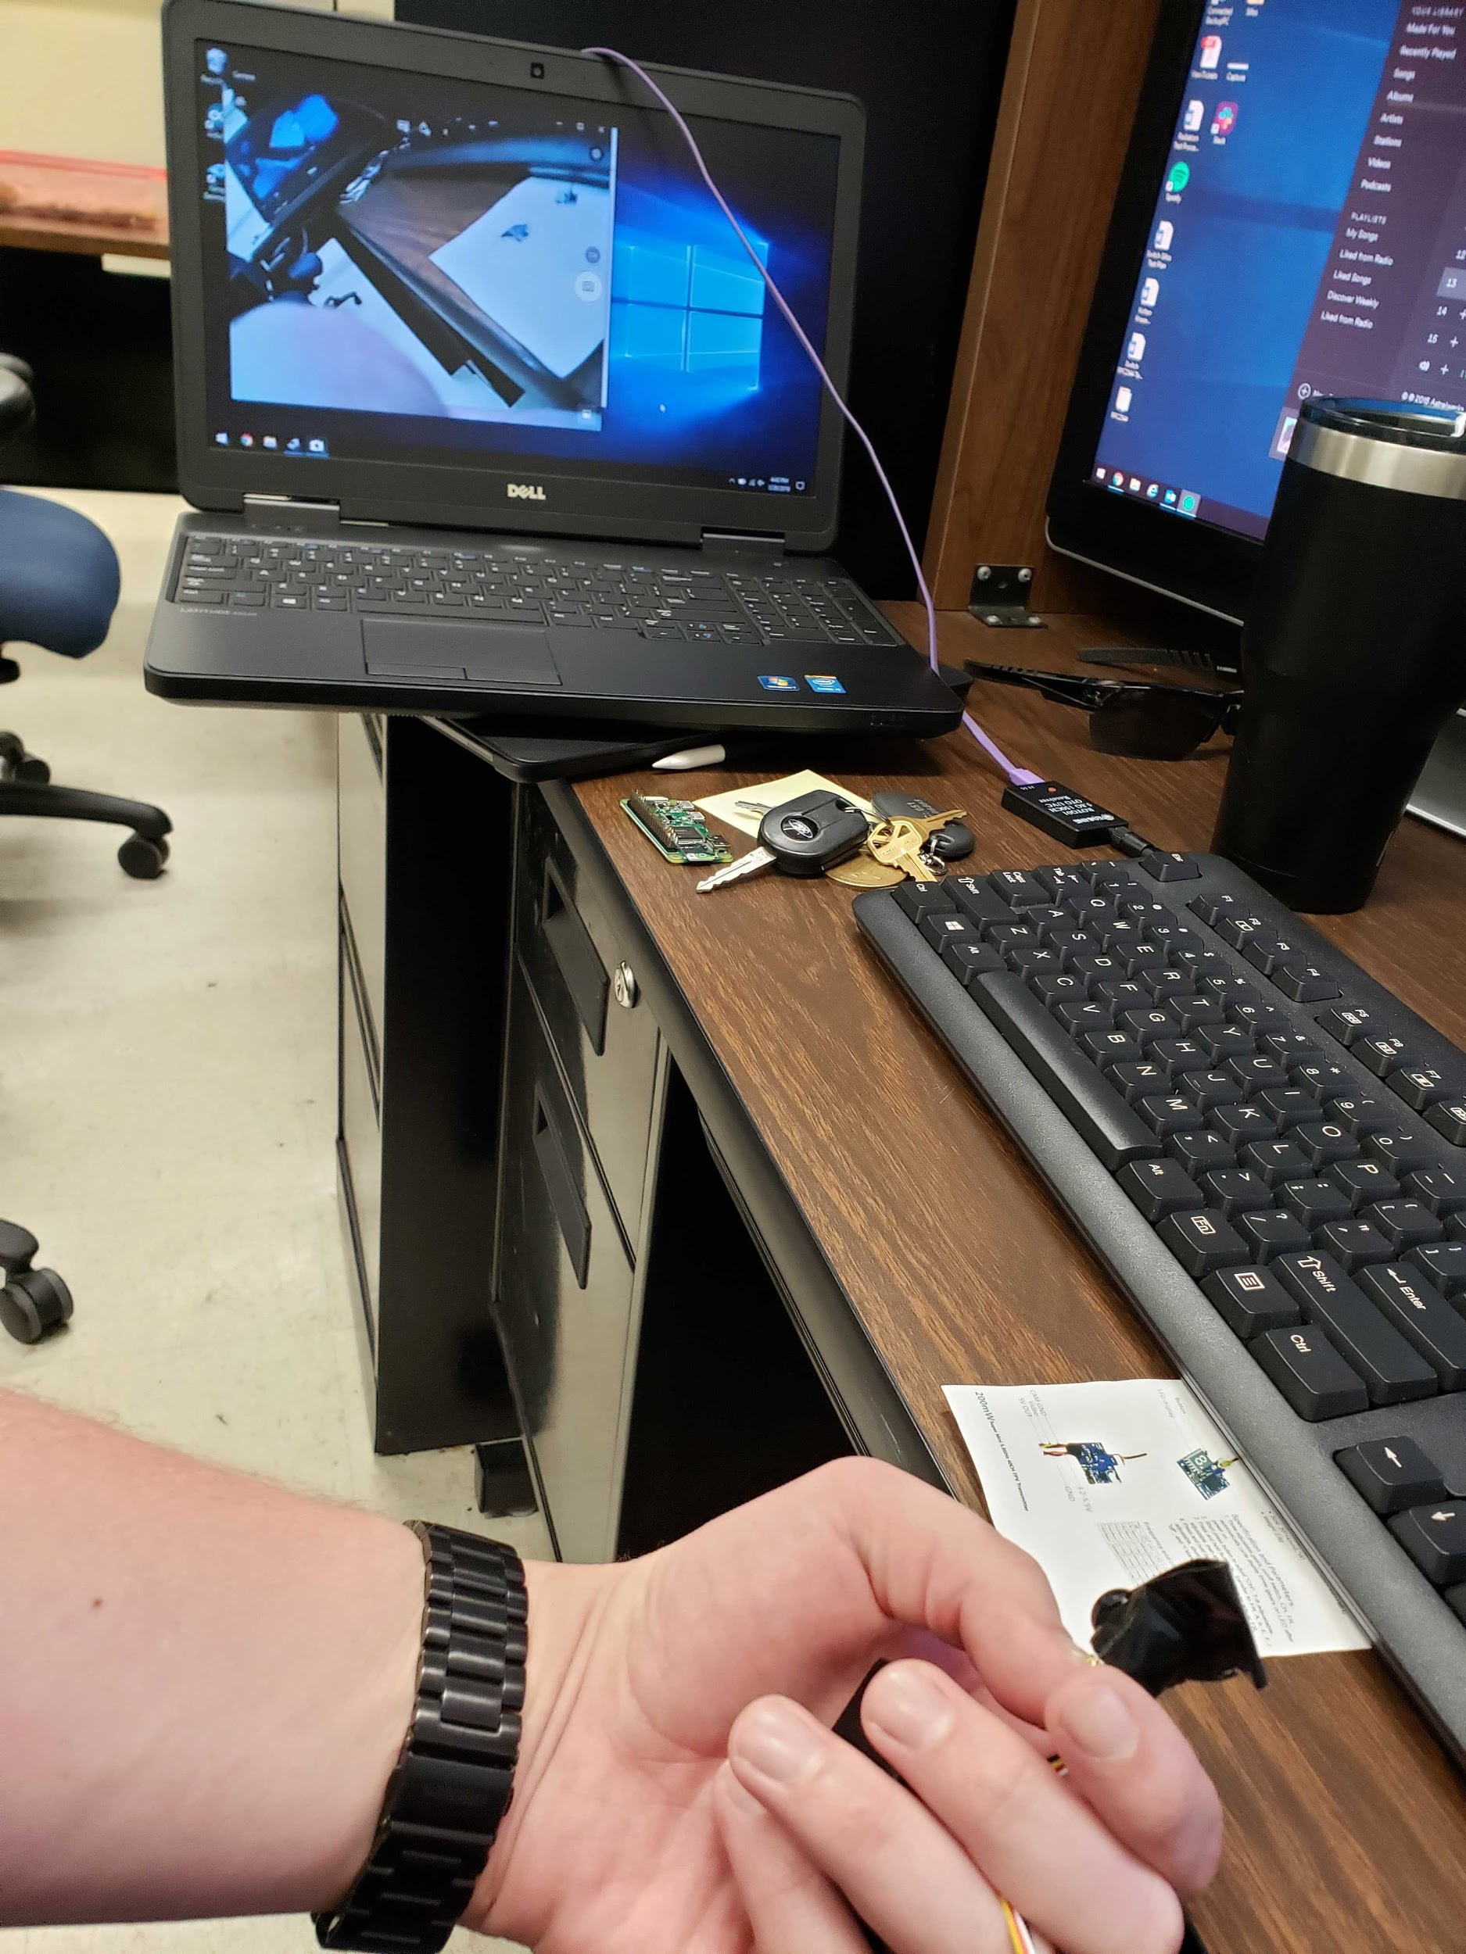
Displays
GroundPi
Website
Hosted by Ground PC
Screen capture of live display on monitor
Launch Control Box
7-segment displays for Altitude, Barometer, Accelerometer
Notes:
Elliot

Slide 9
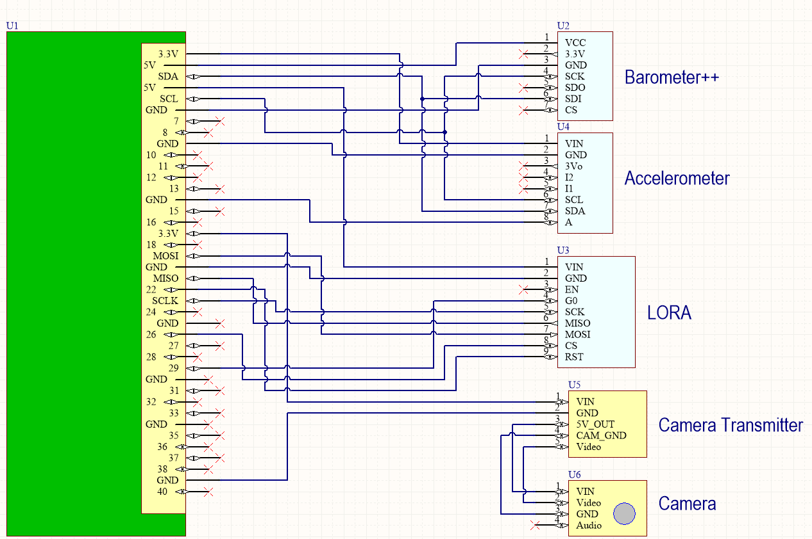
RockPi
Pi Zero
Notes:
MDT

Slide 10
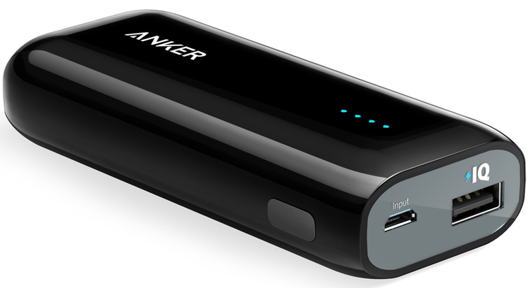
Power
Anker Astro E1 Battery
Capacity: 5200 mAh / 19.24 Wh
Output: 5 V / 2 A
Weight: 119 g / 4.2 oz
Size: 3.8 x 1.7 x 0.9 in
Notes:
MDT

